Slide 1
TOWN & PARISH CLERKS BRIEFING
Local Government
Reorganisation in Hertfordshire
What's been decided, what happens next, and what it means for your council
August 2026
Notes:
Welcome and introduce the purpose: to give clerks a clear, practical update on where Hertfordshire's Local Government Reorganisation stands now that Government has made its decision, what the timetable looks like, and — most importantly — what it means for town and parish councils specifically.

Slide 2

CONTEXT
The journey so far
How Hertfordshire arrived at a decision
1
2
3
4
Late 2024
Nov 2025
Feb–Mar 2026
16 Jul 2026
Government sets out plans
Councils submit proposals
Statutory consultation
Government decision
Devolution White Paper asks two-tier areas, including Hertfordshire, to bring county and district services together.
All 11 Hertfordshire councils and the PCC jointly submit three unitary model options to Government.
A 7-week public consultation runs on the three options; HAPTC submits a response on behalf of parish and town councils.
Government confirms four new unitary councils for Hertfordshire, subject to parliamentary approval.
Hertfordshire Local Government Reorganisation • Update for Town & Parish Clerks
02
Notes:
Quick recap for context — most clerks will know the headlines, so move through this briskly. The key point to land: this has gone from White Paper, to local proposals, to a genuine public consultation that HAPTC responded to on behalf of the parish sector, and now to a confirmed Government decision.

Slide 3


THE DECISION
Four new unitary councils
Confirmed 16 July 2026, subject to parliamentary approval
West
Hertfordshire
South West
Hertfordshire
Dacorum Borough Council and St Albans City & District Council
Hertsmere, Three Rivers and Watford Borough Councils
Central
Hertfordshire
East Hertfordshire
& Broxbourne
North Herts (minus 5 wards), Stevenage and Welwyn Hatfield (minus Northaw & Cuffley ward)
Broxbourne and East Herts, plus Northaw & Cuffley ward and 5 Royston-area wards from North Herts
Hertfordshire Local Government Reorganisation • Update for Town & Parish Clerks
03
Notes:
Walk through the four new authorities. Note the boundary detail for Central, and East Herts & Broxbourne — these split North Herts and Welwyn Hatfield along ward lines, so clerks whose parishes sit in North Herts or Welwyn Hatfield need to check which new authority their own patch falls into. Mention the 'Find your new local authority' look-up tool on hertfordshire-lgr.co.uk if useful.

Slide 4
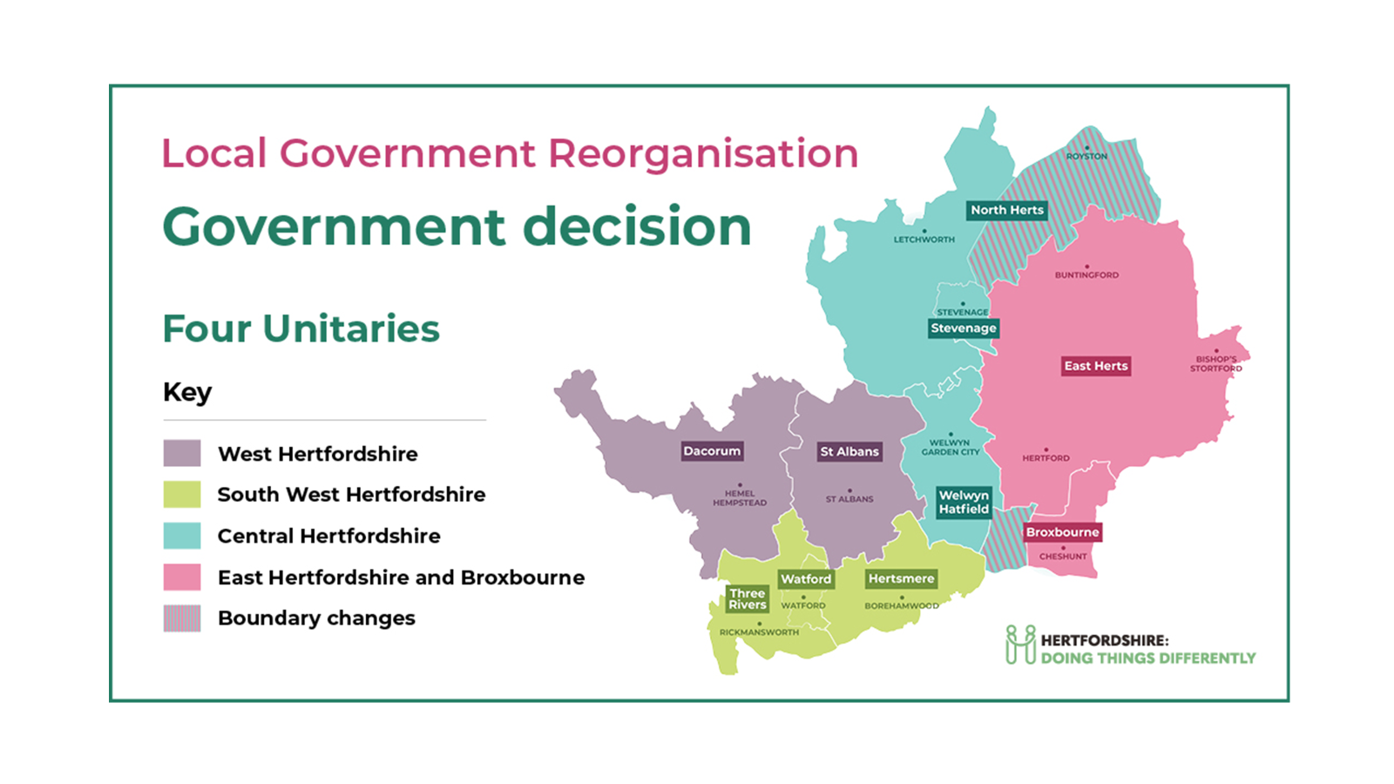

Slide 5

TIMETABLE
What happens, and when
Three dates to hold in mind
NOW
MAY 2027
1 APR 2028
Business as usual
Shadow authority elections
New councils go live
County, district and borough councils continue to deliver all services exactly as before. Nothing changes for residents yet.
Elections held for councillors of the four new unitary councils, who sit as 'shadow authorities' alongside existing councils.
The county council and 10 district/borough councils are abolished. The four unitary councils take on all their functions.
Hertfordshire Local Government Reorganisation • Update for Town & Parish Clerks
04
Notes:
Three anchor dates for clerks to remember and pass on to councillors: nothing changes today; shadow elections in May 2027; full go-live 1 April 2028. Flag that all of this remains subject to the necessary parliamentary legislation (a Structural Changes Order) being made.

Slide 6

YOUR COUNCIL
Where your council stands
The headline: town and parish councils are not being abolished
What stays the same
What will change around you
✓
You are not part of Local Government Reorganisation — LGR restructures the county and district/borough tier only.
Who you liaise with for planning, highways and licensing will change once the new unitary is live.
✓
Your council keeps its existing legal status, functions and precept-raising power.
Service level agreements and grant arrangements with your district/borough will need re-establishing with the new unitary.
✓
You remain the first tier of local democracy, closest to residents on the ground.
Some parish/town boundaries and arrangements are being reviewed now, ahead of the changeover (see next slide).
Hertfordshire Local Government Reorganisation • Update for Town & Parish Clerks
05
Notes:
This is the reassurance slide — lead with it clearly, because it's the question every clerk and councillor will be asking. Government's own FAQ is explicit: town and parish councils are not affected by LGR itself. But be honest about the knock-on effects: new partners to build relationships with, and live local reviews that could change ward boundaries or councillor numbers.

Slide 7

ACT NOW
Community Governance Reviews under way
Some districts are reviewing parish arrangements ahead of 2028
A Community Governance Review (CGR) is the legal process a district or borough council can use to review parish/town ward boundaries, councillor numbers, election arrangements — and whether new parish councils should be created.
North Herts
St Albans
Three Rivers
Welwyn Hatfield
CGR completed: parish councillor numbers reduced 12→9 in one parish; ward boundary changes agreed.
Decision taken 15 Jul 2026 to create a brand-new parish council for central St Albans.
CGR consultation live now, asking whether un-parished areas want a new parish council.
Consulting residents on creating a new parish council for Welwyn Garden City.
Hertfordshire Local Government Reorganisation • Update for Town & Parish Clerks
06
Notes:
This is the practical, time-sensitive part. CGRs are happening district by district, on different timetables, and they can change ward boundaries, councillor numbers, or even create brand-new parishes — all ahead of and independent of the main LGR timetable. Clerks should find out whether their own district is running or planning a CGR and make sure their council responds.

Slide 8


EMERGING IDEA
Neighbourhood Area Committees
A proposed way to keep a local voice inside bigger unitary councils
What Government has floated
Still to be settled
In June 2025 the Local Government Minister said Government wants to promote Neighbourhood Area Committees (NACs) — a standardised way for communities to work with, and be heard by, the new unitary councils.
NACs could include existing parish and town councillors alongside unelected community and business representatives.
NACs are not statutory bodies, so their powers and funding are undecided.
Because members can be unelected, some commentators (including academics Colin Copus and Steven Leach) have raised democratic accountability concerns.
The precise relationship between NACs and existing parish/town councils has not yet been defined.
Hertfordshire Local Government Reorganisation • Update for Town & Parish Clerks
07
Notes:
Present this evenhandedly — it's genuinely unresolved. NACs are Government's suggested answer to 'how do residents stay connected to a much bigger council', but there's no statutory footing yet and real open questions about accountability and how they'd relate to parish and town councils. Worth flagging to councillors so nobody is blindsided if it appears in a future consultation.

Slide 9

ELECTIONS
What this means for elections
Three separate electoral threads running in parallel
Your parish/town elections
Continue on their normal cycle where due to take place in May 2027, but will likely be for a 5 year term to 2032 – the Structural Changes Order will lay down the election requirement . If a Community Governance Review changes your ward boundaries or councillor numbers, the next ordinary election will reflect the new arrangements.
1
Shadow unitary elections — May 2027
All-out elections of councillors for the four new unitary authorities. District and borough elections due in May 27 are likely to be cancelled in the Structural Changes Order — details to follow.
2
County council elections
Hertfordshire County Council is due to be abolished on 1 April 2028, so no further county elections are expected after the new unitaries are established.
3
Hertfordshire Local Government Reorganisation • Update for Town & Parish Clerks
08
Notes:
Given the audience's own RO/DRO background, this is worth spelling out precisely: three electoral threads are running side by side — ordinary parish elections (unaffected in principle, though subject to any CGR outcome), the new shadow unitary elections in May 2027, and the wind-down of county elections. Confirm that the government has not yet published detail on what happens to any district/borough elections that would otherwise fall before 2028.

Slide 10

NEXT STEPS
What to do now
A practical checklist for the months ahead
1
2
3
Check for a Community Governance Review
Brief your councillors
Keep talking to your district/borough
Find out if your district/borough is running or planning one, and make sure your council submits a response.
Share this information at your next full council meeting so members understand the timetable and what is, and isn't, changing.
Existing service agreements, grants and planning liaison continue until 2028 — don't let relationships lapse early.
4
5
6
Watch for Neighbourhood Area Committee proposals
Stay connected through HAPTC
Plan ahead for precepts and budgets
No decisions yet but be ready to feed in a view if and when a consultation appears.
The Hertfordshire Association of Town & Parish Councils is your collective voice — read the monthly bulletin and raise questions there.
Build the possibility of new unitary counterparts and revised boundaries into your medium-term financial planning.
Hertfordshire Local Government Reorganisation • Update for Town & Parish Clerks
09
Notes:
Six concrete actions. If time is short in the live session, prioritise items 1, 2 and 5 — checking for a CGR, briefing councillors, and staying plugged into HAPTC — as the three with the nearest deadlines.

Slide 11

QUESTIONS & RESOURCES
Where to go for more
hertfordshire-lgr.co.uk
Official joint council site — timeline, FAQs and the 'find your new authority' look-up tool.
haptc.org.uk
Hertfordshire Association of Town & Parish Councils — bulletins, training and your collective voice in the process.
gov.uk
Search 'Local government reorganisation Hertfordshire' for the statutory consultation and decision documents.
Thank you — happy to take questions now.
Hertfordshire Local Government Reorganisation • Update for Town & Parish Clerks
10
Notes:
Close by pointing clerks to the three go-to sources, and open the floor. Likely questions: exact boundary of their own parish within the new unitary, timing of any CGR in their district, and how precepts will be collected post-2028 — flag that billing/precept mechanics haven't been published yet and will follow in due course.

